Slide 1
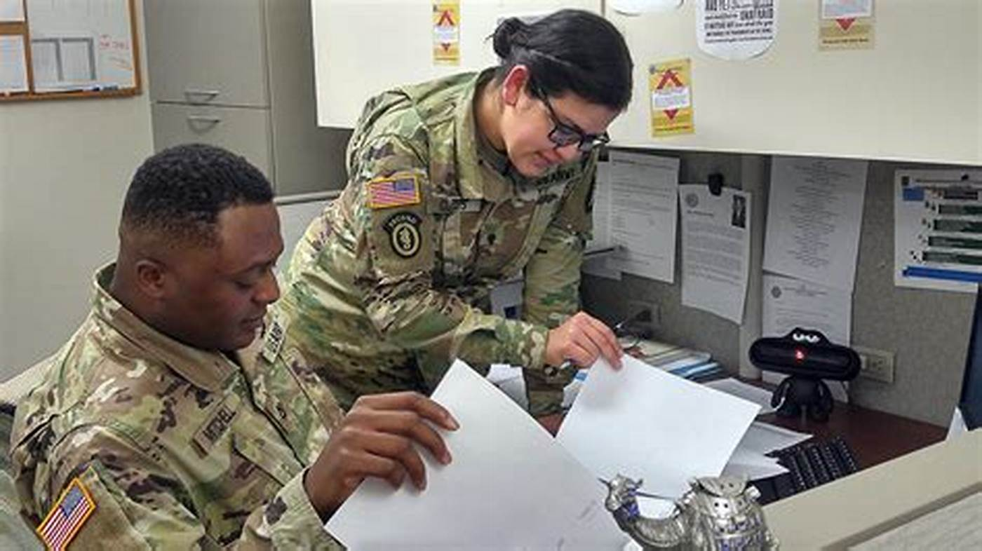
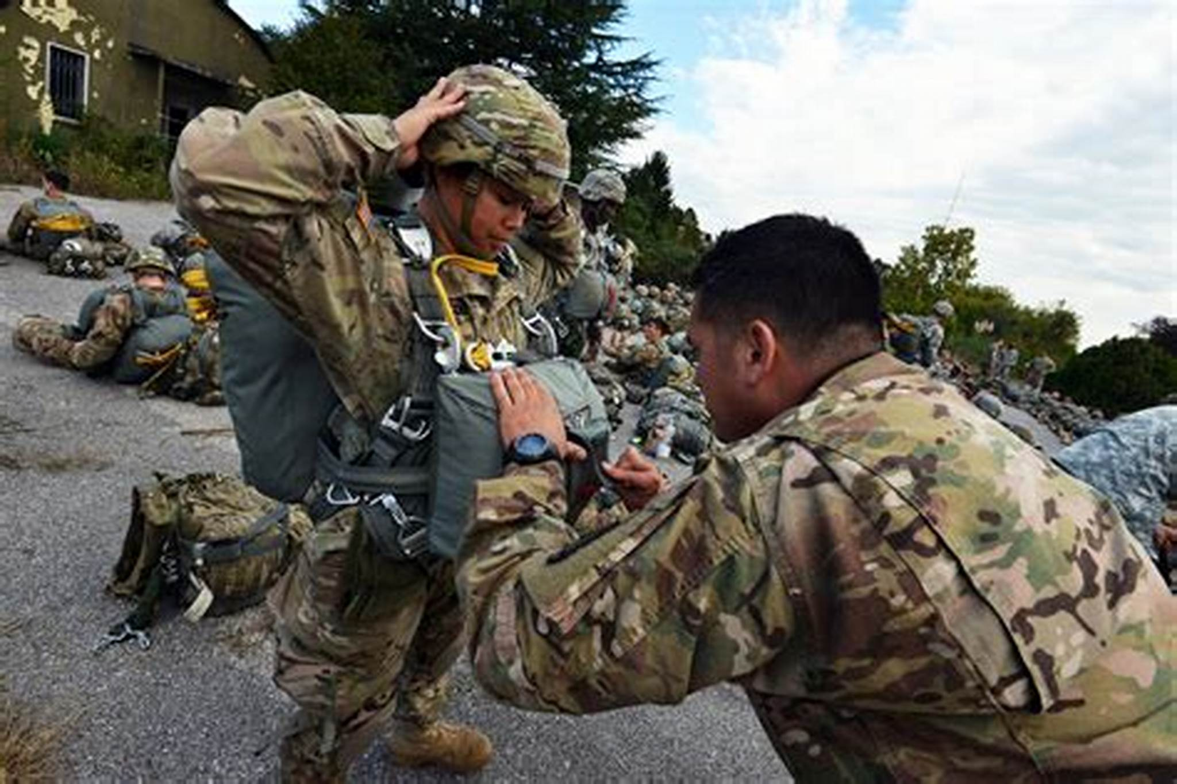
Inspections

Slide 2

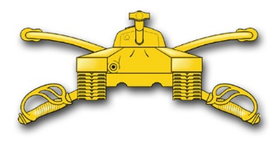
Instructor Information

Slide 3
Basic Ground Rules
Please ask questions relevant to the topic of Inspections.
Please avoid personal Internet / email use during class time and practical exercises.
Keep the chat window professional. No memes or gifs.
Please keep your microphone on mute
We start on time.

Slide 4
Inspections Terminal Learning Objective
Action: Resolve a systemic issue in a functional area.
Conditions: Given Army Regulation 1-201, Army Regulation 20-1, The Inspections Guide, The Inspector General Reference Guide (Part 8), classroom handouts, classroom instruction, and an inspection topic.
Standard: Apply the seventeen steps of the three-phased Inspector General Inspections Process, write a Findings Sections that accurately reflects the information gathered during the inspection, and describe the Organizational Inspection Program (OIP).

Slide 5
ELOs
ELO
Knowledge-based ELOs:
1. Define the following terms:
- Inspection
- Standard
- Initial Command Inspection (ICI)
- Subsequent Command Inspection (SCI)
- Root Cause
- In-Process Review (IPR)
- Crosswalk
- Handoff

Slide 6
ELOs
ELO
Describe the purpose of the Organizational Inspection Program (OIP).
Describe the IG’s role in the OIP.
Describe the five Inspection Principles.
Identify the three inspection categories (Command, Staff, and IG).
Identify who may direct an IG Inspection.

Slide 7
ELOs
ELO
Describe the Root-Cause Analysis Model.
Identify the battalion as the lowest level organization in which a commander has a staff to perform internal inspections on subordinate units as part of an OIP.
Describe the three phases of the Inspections Process (Preparation, Execution, and Completion).
Identify the five information-gathering domains (Interviews, Sensing Sessions, Document Review, Observation, Surveys / Questionnaires).

Slide 8
ELOs
ELO
11. Identify the five parts of the recommended findings section format.
  - Finding Statement
  - Standard
  - Inspection Results (Discussion)
  - Root Cause
  - Recommendation(s)

Slide 9
ELOs
ELO
12. Describe the Impact of the rules of IG records on IG Inspection Reports.
13. Describe the nature of Compressed IG Inspections.
14. Apply the three-phase, 17-step Inspections Process.
15. Apply the Root-Cause Analysis Model.
16. Complete a findings section using the appropriate information.
Application-based ELOs:

Slide 10
Inspections Training Schedule
Day 2 (Tuesday)
  1000-1200 Inspection Principles and Organizational Inspection Program (OIP)
  1200-1800 Inspections Process
  Day 3 (Wednesday)
  1000-1800 Inspections Process
  Day 4 (Thursday)
  1000-1900 Inspections Process

Slide 11
Inspections Training Schedule
Day 5 (Friday)
  1000-1100 Intelligence Oversight
  1100-1200 ELO Review
  1200-1300 Inspections Quiz
  1300-1400 Post Quiz Review and Issue Graded Homework

Slide 12

References
Army Regulation 1-201, Army Inspection Policy
Army Regulation 20-1, Inspector General Activities and Procedures
Army Regulation 381-10, U.S. Army Intelligence Activities (CD)
The Inspections Guide
The Intelligence Oversight Guide (CD)
OIP Guide for Commanders (CD)
Advance Sheets
The IG Reference Guide, Part 8, Fort Von Steuben

Slide 13
Army Inspection Policy
Army Regulation 1-201
Identifies responsibilities
Requires Commanders to designate an OIP Coordinator
Defines inspection terms and concepts
Outlines the Army’s inspection principles
Establishes the Organizational Inspection Program
(OIP) -- the most important aspect of AR 1-201
Urges the integration of inspections

Slide 14
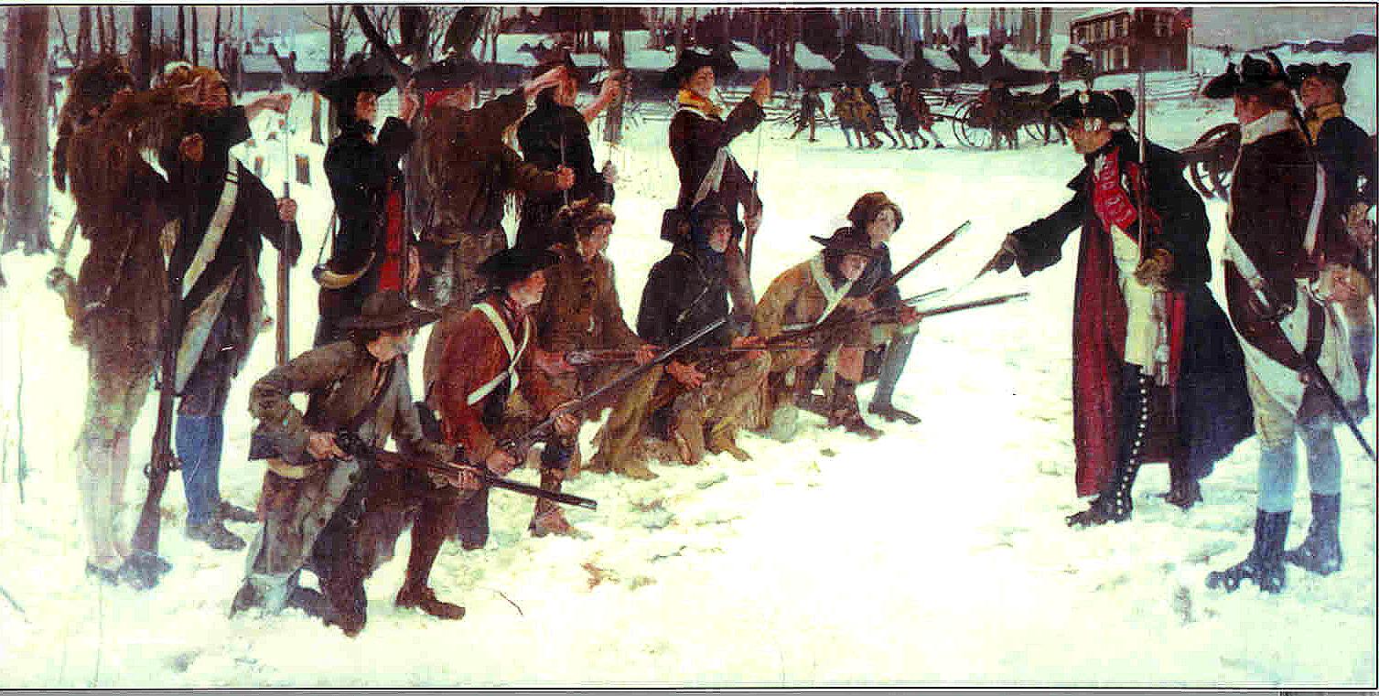
Why do inspections?
Proactively resolves issues that affect unit readiness and warfighting capability.
Promotes and reinforces good performance and best practices.
Underscores leadership priorities.
Provide information to Commanders so they can make decisions that improve the Army’s readiness

Slide 15
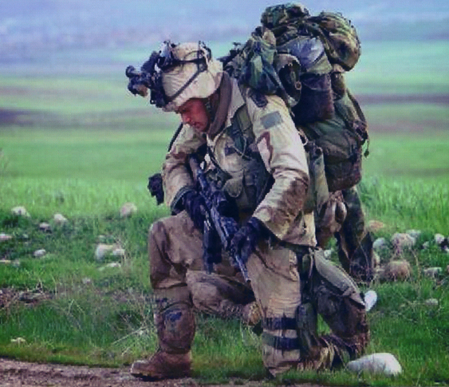
Relevance
An Expeditionary Army
  Global Contingency Operations
  Regionally Aligned Force Deployments
A Changing Army
  Sustainable Readiness to ReARMM
  Reduction / Increase in structure
  Reduce Friction at local and HQDA level

Slide 16

Definition of an Inspection
ELO
1
“An evaluation that measures performance against a standard and should identify the cause of any deviation. All inspections start with compliance against a standard. Commanders tailor inspections to their needs.”
  AR 1-201, Glossary; The Inspections Guide, Section 2-3, page 2-3-1 and 2-3-5
A standard is the way things should be
ELO
1

Slide 17

Searching for Standards
Army Publishing Directorate (APD)
https://armypubs.us.army.mil/
Army G-1 (Pentagon)
http://www.armyg1.army.mil/
Department of Defense Directives
https://www.dtic.mil/whs/directives/
National Guard Bureau
https://www.ngbpdc.ngb.army.mil/
milSuite
https://www.milsuite.mil
Know the proponent for each regulation to fix responsibility, and check the applicability of the regulation.
Does the regulation apply to everyone in the Army?

Slide 18
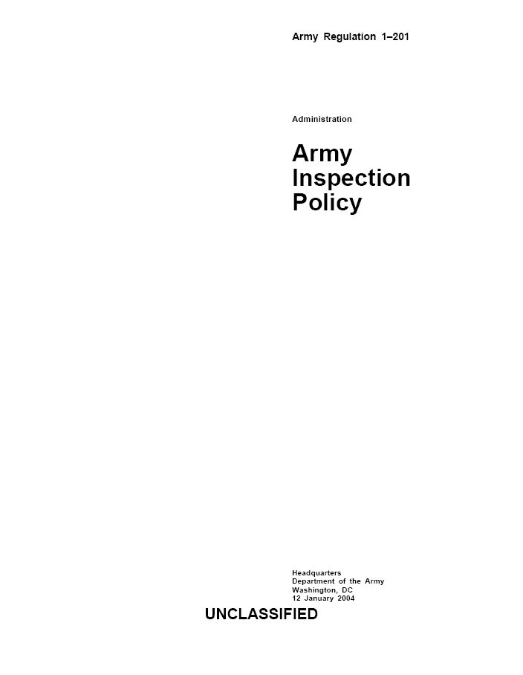
Principles of Army Inspections
ELO
4
1. Purposeful
2. Coordinated
3. Focused on Feedback
4. Instructive
5. Followed up
Five Principles (AR 1-201, paragraph 2-2)

Slide 19
Principles of Army Inspections
1. Purposeful
  The commander approves the specific purpose of the inspection.
    Related to mission accomplishment
    Be tailored to meet the commander’s needs while remaining relevant and responsive
    Be performance-oriented and start with an evaluation against a standard

Slide 20
Principles of Army Inspections
2. Coordinated
  To ensure the proper coordination of inspections, an annual review of all scheduled inspections should occur that answers the following three questions:
    Can this inspection be canceled or combined with another inspection?
    Does this inspection duplicate or complement another inspection?
    Do inspection reports from other agencies or echelons of command exist that can assist in the conduct of an inspection?

Slide 21
Principles of Army Inspections
3. Focused on Feedback – Written inspection reports
  Inspections are critical because they provide the commander / TAG / Program manager / Director with accurate and timely feedback.
  Inspection results include:
    The identification of root causes
    The identification of strengths and weaknesses
    The implementation of corrective actions
    The sharing of inspection results

Slide 22
Principles of Army Inspections
4. Instructive
  Teaching and training is an essential element of all inspections and is the overarching purpose of Staff Assistance Visits.
  No inspection is complete if the units or agencies inspected have not learned about goals and standards and how to achieve them.

Slide 23
Principles of Army Inspections
5. Followed up
  Inspections expend valuable resources and are not complete unless a unit or agency develops and executes a follow-up inspection or plan to ensure the implementation of corrective actions.
  Follow-up actions can include:
    Re-inspections
    Telephone calls or visits to proponents to check on the progress of corrective actions
    Requests for formal responses (Reply by Memorandum)

Slide 24
Summary
ELO 1: Define the term Inspection
ELO 1: Define the term Standard
ELO 4: Describe the five Inspection Principles

Slide 25
The Organizational
Inspection Program
(OIP)
AR 1-201, Chapter 3
The Inspections Guide, Chapter 5

Slide 26
The Organizational Inspection Program (OIP)
The OIP comprises all inspections within a unit
The OIP is a command responsibility and program
The OIP complements and reinforces other evaluations
The OIP minimizes the duplication of evaluations
The IG is the proponent for inspection policy
The G-3, S-3, or equivalent OPS agency is normally responsible for coordinating the overall program
AR 1-201, paragraph 3-2

Slide 27
Purpose of the OIP
ELO
2
To coordinate inspections and audits into a single, cohesive program focused on command objectives
The OIP provides the commander with an organized management tool to identify, prevent, or eliminate problem areas.
AR 1-201, paragraph 3-2, a & b

Slide 28
The Integration of Inspections
Do all of these inspections work in unison?
Are they complementing and not duplicating each other?
O I P
COMMAND INSPECTION
STAFF INSPECTION
IG INSPECTION
Audits
Staff Assistance Visits
External Inspections
Internal Control
Intelligence Oversight
AR 1-201, paragraphs 3-2 to 3-5

Slide 29
Role of the IG in the OIP
ELO
3
Develop the IG Inspection Program as part of the OIP
Advise and mentor commanders and staffs on inspection policy
Advise the commander on the OIP’s effectiveness
Conduct IG Inspections
AR 20-1, paragraph 5-1g
AR 1-201, paragraph 1-4

Slide 30
Role of the OIP Coordinator
Develop and maintain the written OIP for the unit or command
Coordinate the execution of all inspection programs within the unit or command
Maintain a calendar or schedule of planned inspections
Serve as the executive agent for the Command Inspections (if required)
Inspections Guide, page 5 - 4 - 1

Slide 31
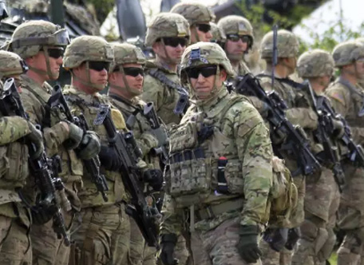
Categories of Inspections
ELO
5
Command Inspection
Staff Inspection
Inspector General Inspection
AR 1-201, paragraphs 3-2 to 3-6

Slide 32
Command Inspections
A scheduled, formal event
Led by the Commander
Initial Command Inspection (ICI) (company or detachment)
Subsequent Command Inspection (SCI)
AR 1-201, paragraph 3-3

Slide 33
Initial Command Inspection
ELO
1
Required for Company Commanders (or like commands: detachments, troops, batteries)
Inspecting Commander must be present and participating in the inspection (USAR and ARNG consider consolidating inspections to facilitate presence)
Timing:
      Within 90 days of change of command for the Active Component
      Within 180 days of change of command for National Guard (NG) and U.S. Army Reserve (USAR)
AR 1-201, paragraph 3-3c

Slide 34
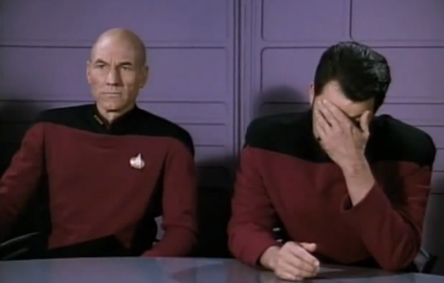


Initial Command Inspection
ELO
1
Identifies unit strengths and
weaknesses
Cannot be used to evaluate
the Company Commander
Helps commanders establish
goals, standards, and priorities
Not used to compare units
Only the inspected commander and that commander’s rater will receive the specific results (IG can request results without unit attribution)
CDR
XO
AR 1-201, paragraph 3-3c

Slide 35
Subsequent Command Inspection
ELO
1
Measures progress and reinforces goals and objectives established during the Initial Command Inspection (ICI).
The inspecting commander may use the results of the Subsequent Command Inspection to evaluate the company commander.
Per SecArmy Memorandum, Prioritizing Efforts-Readiness and Lethality (Update 3) dated 23 April 2018, SCIs are no longer required but are still an option for Commanders.
SCIs still have value, in keeping with the Followed-Up Inspection Principle, because SCIs ensure the implementation of corrective actions and the continued assessment of company-level readiness
The inspecting commander must be present
and participating in the inspection!
AR 1-201, paragraph 3-3d

Slide 36
Staff Inspection
Led by a staff member of a functional area
Focuses on a single functional area or a few related areas
Conducted by the lowest-level staff member technically qualified in the functional area
Should complement Command and IG Inspections
Compliance oriented

Slide 37
Staff Assistance Visit (SAV)
Directly support Staff Inspection and Command Inspection Programs
Assist, teach, and train subordinate staff sections on how to meet the required standards of a particular functional area
Can prepare staff sections for upcoming inspections or train them on new concepts, technologies, or operating techniques

Slide 38
Inspector General Inspection
Inspector General inspections should:
  Pursue systemic issues
  Identify sub-standard performance, determine the magnitude of the deficiency, and seek the reason for the deficiency (the root cause)
  Teach systems processes and procedures
  Identify responsibility for corrective actions
  Spread innovative ideas

Slide 39
Who May Direct an IG Inspection?
ELO
6
Secretary of the Army (SA)
or Under Secretary of the Army
Chief of Staff
of the Army (CSA)
or
Vice Chief of Staff of the Army (VCSA)
Inspection Directive
The
Inspector General
(TIG)
Commander (Directing Authority)
AR 20-1, Glossary, Section II (page 111)

Slide 40
Systemic and Local Problems
What is the difference?
Systemic problems are usually widespread and present a pattern. You can often trace these problems back to a regulation, policy, or other standard that is confusing, overly ambitious, or in conflict with another standard. The proponent is usually the person to fix this type of problem.
Local problems usually affect a small group of people or an individual and do not present a pattern. You can usually trace these problems back to a particular person’s decision, demeanor, or statements. The level of organization that the problem affects is the best place to solve this problem.

Slide 41
Systemic and Local Problems
What is the difference?
Several Soldiers in Company C, 3rd Battalion, 66th Infantry, failed to receive their Basic Allowance for Subsistence (BAS) in their End-of-Month (EOM) pay.
Is this problem a systemic or a local problem?

Slide 42
Systemic and Local Problems
What is the difference?
A lieutenant recently conducted a Permanent Change of Station (PCS) from Germany to Fort Von Steuben. Sixty days have passed, and he has still not received his household goods.
Is this a systemic or a local problem?

Slide 43
Systemic and Local Problems
What is the difference?
For the past six months, 31 percent of the Army National Guard Soldiers mobilized to Fort Von Steuben’s Power-Projection Platform are found to be Dental Category 3 or 4 (Non-deployable). Twenty-five percent of the U.S. Army Reserve Soldiers are also Dental Cat 3 / 4 upon arrival to Fort Von Steuben.
Is this problem a systemic or a local problem?

Slide 44
Summary
ELO 1: Define the term Initial Command Inspection
ELO 1: Define the term Subsequent Command Inspection
ELO 2: Describe the Organizational Inspection Program
ELO 3: Describe the IG’s role in the OIP
ELO 5: Identify the three inspection categories
ELO 6: Identify who may direct an IG Inspection

Slide 45
Why do units and people fail to comply with standards?
“That is the way we did it in my old unit.”
“I have no idea what you are talking about. I have been the S-1 for only two days.”
“Take a number. We have two CTC rotations, an OEF planning conference, and brigade formal in front of you.”
“I can’t get any good help these days. I am on my butt because all of my staff officers are young lieutenants!”
“I don’t understand … I thought I understood ... I did it right the last time, but …”
What are some reasons you may have heard?

Slide 46
The Root Cause Analysis Model
ELO
7
NON-COMPLIANCE
DON’T KNOW
CAN’T COMPLY
WON’T COMPLY
NEVER KNEW
FORGOT
TASK IMPLIED
FEW RESOURCES
DON’T KNOW HOW
IMPOSSIBLE
NO REWARD
NO PENALTY
DISAGREE
Root Cause: The underlying reason why something happens or does not happen.
The Inspections Guide, Section 3-3, pages 3-3-1 to 3-3-3

Slide 47
Don’t Know
Why not?
Never knew – The problem may be systemic in terms of getting guidance down to the user level.
Forgot – The problem is usually a local or personal issue.
Task implied – The problem could result from a lack of experience or specific guidance.
Look for written SOPs, regulations, policies, and so on.

Slide 48
Can’t Comply
Why not?
Scarce resources / low priority – Always look at the big picture.
Don’t know how – Possibly a lack of training.
Impossible – The unit or individuals may not even be able to accomplish the task.

Slide 49
Won’t Comply
Why not?
No reward – Check for incentives.
No penalty – Nobody cares.
Disagree – The unit or individual may be seeking an exception to policy or a change to the rules.

Slide 50
Root Cause Analysis as a Flow Chart
START
YES
GOOD NEWS!
SPREAD IT
AROUND!
COMPLIANCE?
MEETS STANDARD?
NO
YES
YES
THEN THEY
CHOSE NOT
TO COMPLY
WHAT ARE THE
REWARDS
FOR MEETING
THE STANDARD?
KNOWS ABOUT
REQUIREMENT &
STANDARD?
SUFFICIENT
RESOURCES?
Try the 5 why analysis
NO
NO
ROOT CAUSE
MAY BE:
NEVER KNEW
IMPLIED TASK
FORGOT
WHICH RESOURCE IS LACKING?
TIME? MANPOWER?
MONEY? EQUIPMENT?
FACILITIES? KNOWLEDGE?
WHAT ARE THE
PENALTIES
FOR NOT MEETING
THE STANDARD?
WHY DID
THEY CHOOSE
NOT TO
COMPLY?
WRITE AN APPROPRIATE
ROOT CAUSE AND
RECOMMENDATION
STOP

Slide 51
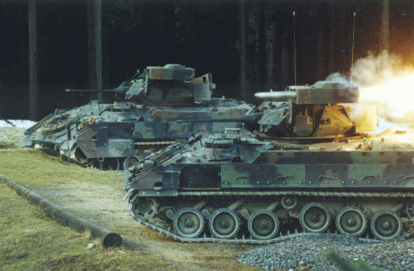
Root Cause
Case Study 1
Twenty percent of an infantry battalion’s vehicle fleet is suffering from Class II oil leaks.
The vehicle drivers said that they just tighten the bolts, wipe off the spot, and keep an eye on the leak.

Slide 52
Root Cause
Case Study 1
Twenty percent of an infantry battalion’s vehicle fleet is suffering from Class II oil leaks.
The vehicle drivers said that they just tighten the bolts, wipe off the spot, and keep an eye on the leak.
What is the standard?
Tighten, wipe, and observe!
We have a good news story!
Is a root cause applicable?

Slide 53
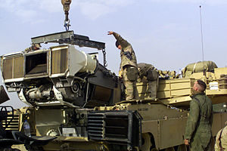
Root Cause
Case Study 2
Drivers are not conducting Preventive Maintenance Checks and Services (PMCS) to standard on their respective vehicles. They were told of the requirement during the morning formation.
Noncommissioned Officers (NCOs) are not in the motor pool to supervise the drivers during Command Maintenance due to competing requirements.

Slide 54
Root Cause
Case Study 2
Drivers are not conducting a PMCS to standard on their respective vehicles.
NCOs are not in the motor pool to supervise the drivers during Command Maintenance due to competing requirements.
What is the standard?
Perform a proper PMCS on the vehicles.
NCOs: Can’t comply because of competing requirements.
Drivers: Can’t comply due to a lack of experience and knowledge even though they are aware of the standard to conduct PMCS.

Slide 55
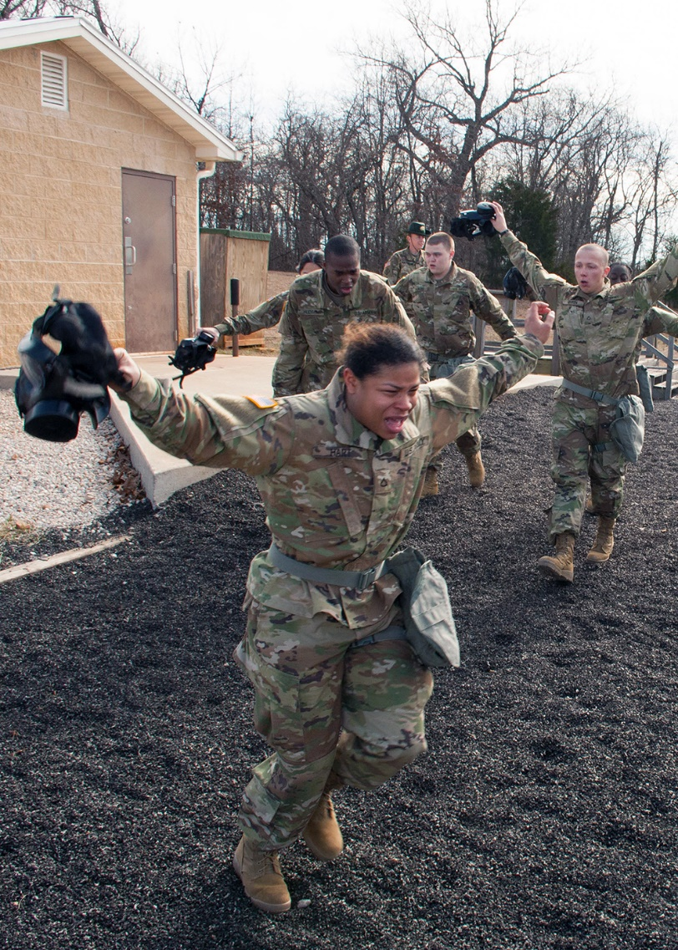
Root Cause
Case Study 3
An armor battalion’s Chemical, Biological, Radiological, and Nuclear (CBRN) equipment is not calibrated.
The unit understands the calibration requirement, but the Test, Measurement, and Diagnostics Equipment (TMDE) shop at the Sustainment Brigade will not accept the job orders.
The TMDE shop does not have the required personnel and equipment to conduct calibration and does not want to suffer the downtime.

Slide 56
Root Cause
Case Study 3
An armor battalion’s CBRN equipment is not calibrated.
The unit understands the calibration requirement, but the TMDE shop will not accept the job orders.
The TMDE shop does not have the required personnel and equipment to conduct calibration and does not want to suffer the downtime.
What is the standard?
Annual calibration of all CBRN equipment
Unit: Can’t comply because the TMDE shop won’t accept the job orders (symptom of the TMDE’s root causes).
TMDE: Can’t and won’t comply due to lack of resources and the downtime penalty involved (a symptom as well).

Slide 57
Types of Inspections
General Inspection. These inspections are broad in scope, oriented on units, and designed to look at all aspects of the organization. (Once called compliance inspections)
Special Inspection. These inspections are focused on specific functions, programs, procedures, problems, or issues; these inspections also look at groups of related problems or procedures. The special inspection facilitates the systemic approach to an inspection and is the preferred type of IG Inspection.
Follow-up Inspection. These inspections review the effectiveness of corrective actions taken as a result of a previous inspection.
The Inspections Guide, Section 2-3, pages 2-3-2 to 2-3-3

Slide 58
O I P
COMMAND
INSPECTION
STAFF
INSPECTION
IG INSPECTION
Special
Follow–up
General
General
Special
Follow-up
General
Special
Follow-up
All three inspection categories can contain the three types of inspections.

Slide 59
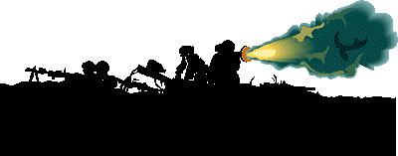
OIP: Battalion
ELO
8
The battalion is the lowest level organization in which a commander has a staff to perform internal inspections on subordinate units as part of an OIP.
The Battalion OIP normally includes Command Inspections (Initial and Subsequent) and Staff Inspections
The Battalion OIP focuses on areas that immediately impact readiness and reinforce goals and standards
Teaching, training, and mentoring is a goal of company-level Command Inspections
AR 1-201, paragraph 3-2c

Slide 60
OIP: Brigade
The Brigade OIP, at a minimum, will include guidance on Command Inspections, Staff Inspections, and SAVs
The Brigade OIP focuses on units and functional areas
The Brigade OIP should include inspections of the brigade headquarters company
The Brigade OIP must complement the battalion commanders’ programs and avoid redundancy

Slide 61
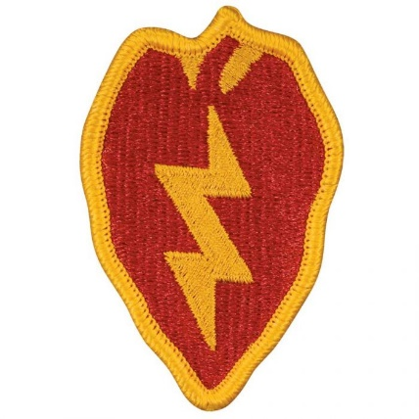


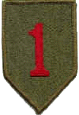
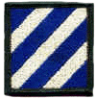



OIP: Division
The Division OIP consists primarily of Staff Inspections, SAVs, and IG Inspections
At a minimum, the Division OIP must:
  Establish a plan to check the OIP’s effectiveness (an IG role)
  Protect subordinate commanders from being over-inspected
  Incorporate Intelligence Oversight Inspections
  Disseminate lessons learned

Slide 62
Developing an OIP
Your unit or command’s OIP will normally exist in the form of a local regulation or memorandum.
The OIP document should list responsibilities for staff members and subordinate commanders and designate an overall OIP Coordinator.
The Inspections Guide, Chapter 5

Slide 63
Developing an OIP
The OIP document should articulate the commander’s overall inspection guidance.
The OIP document should address the relevant categories of inspections (Command, Staff, and IG) – as they pertain to the command – by frequency, focus, and so on.

Slide 64
Developing an OIP
The OIP document should address Intelligence Oversight within the unit or command.
The OIP document must capture all inspections that affect the command and then prioritize them – or eliminate some of them!
The OIP document should establish the scope and standards for the different types of inspections.

Slide 65

The IG Inspection Selection Process
The Inspections Guide, Section 3-4

Slide 66
The IG Inspection Selection Process
DETERMINE
THE COMMANDER’S
PRIORITIES
The IG must know the Commander
The IG must attend relevant staff meetings and listen in on key topics of discussion
The IG must keep up with all of his or her commander’s current policies and philosophies
The IG must be a visible and participating member of the command

Slide 67
The IG Inspection Selection Process
How do you build an Inspection Priority List?
The IG must be aware of the commander’s guidance and trends within the command.
  Review the IG Database for trends
  Review the Annual Training Guidance
  Review Local Command Policy and Goals
  Know the Command Vision
  Review DAIG and higher headquarters’ inspection priorities
  Study pertinent issues in Unit Status Reports or Strategic Readiness System (SRS)

Slide 68
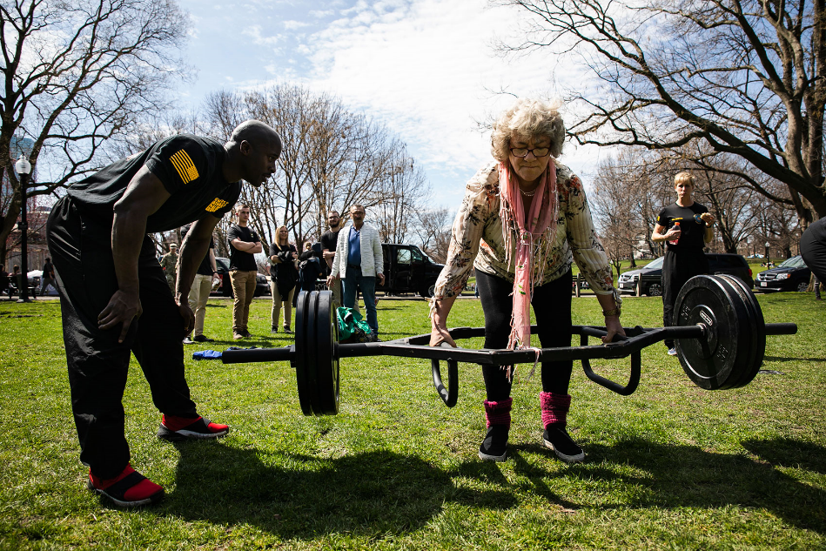
The IG Inspection Selection Process
Analyze your information for its…
Impact on Unit Readiness
Value to the Command
Priority to the Commander
Interesting, but does it matter?

Slide 69
The IG Inspection Selection Process
Develop a Prioritized List.
List the inspection topics by priority
Recommended to develop at least four key inspection topics for the fiscal year (one topic per quarter)
Explain to the commander how and why these inspections will contribute to unit readiness
For example,
1. OIP (1st Quarter)
2. Risk Management (RM) (2nd Quarter)
3. Force Protection (3rd Quarter)
4. Property Accountability (4th Quarter)

Slide 70
The Inspection Selection Process
Generate a list for your Commander’s approval.
CONSIDER THE COMMANDER’S
GUIDANCE AND CURRENT TRENDS
DETERMINE
COMMANDER’S
PRIORITIES
ANALYZE THE
INFORMATION
DEVELOP THE LIST
COMMANDER
APPROVES LIST
1. OIP
2. Risk Management
3. Force Protection
4. Property Accountability
INSPECTION LIST
PUBLISHED

Slide 71
Summary
ELO 7: Describe the Root-Cause Analysis Model
ELO 8: Identify the lowest level organization that has the ability to perform internal inspections on subordinate units

Slide 72
The Inspections Process
RESEARCH
DEVELOP CONCEPT
PLAN IN DETAIL
TRAIN UP
PREPARATION
1
2
CDR
4
5
APPROVES CONCEPT
3
PRE-INSPECTION VISITS
6
IPR
8
ANALYZE
RESULTS
CROSSWALK
OUT-BRIEF PROPONENT
VISIT UNITS
EXECUTION
7
UPDATE CDR
10
11
9
OUT-BRIEF CDR
FINALIZE REPORT
DISTRIBUTE REPORT
SCHEDULE FOLLOW-UP
COMPLETION
12
TASKERS
14
16
17
HANDOFF
13
15
The Inspections Guide
Chapter 4

